Slide 1
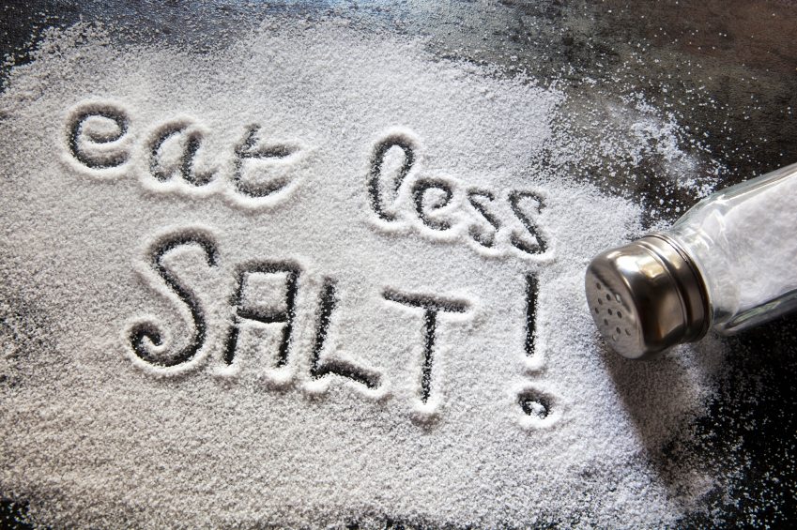
OxSalt Lowering Salt For Health .
Notes:
Welcome. We would like to help people to reduce the amount of salt in their diet. We hope to help you make healthy food choices and help you learn about the amount of salt in everyday foods. This can help to support you and motivate you in eating less salt and this will be good for your health.
You will learn the health benefits of eating less salt, how to understand how much salt is in the food you eat, what food labels mean and the importance of portion size.
There are practical tips on salt reduction on the OxSalt website.

Slide 2
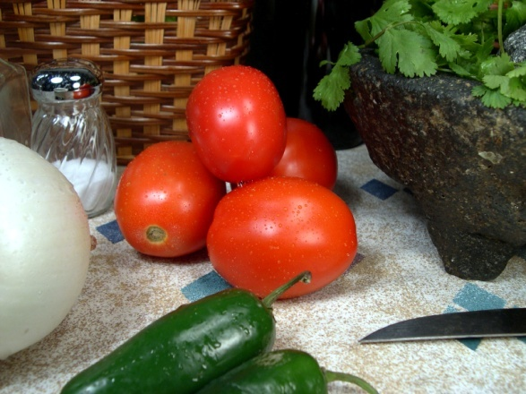

Lowering Salt for Health

Slide 3
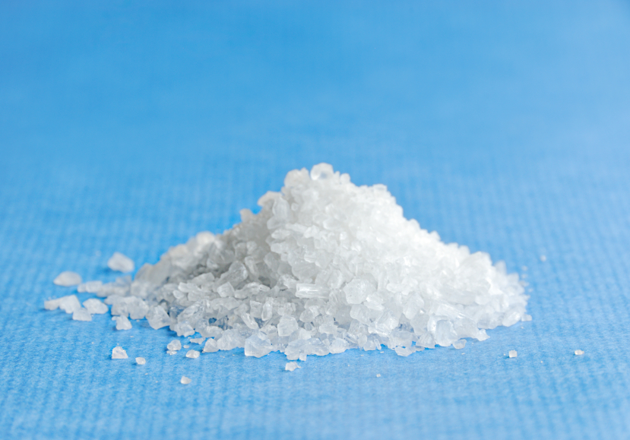
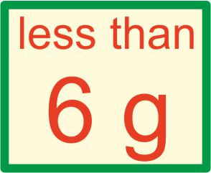
Introduction
What is Salt?
Salt is made up of the minerals sodium and chloride.
It is recommended by the UK National Institute for Health and Clinical Excellence (NICE) that we eat no more than 6 grams of salt per day. By the year 2025 they recommend that we should aim to be eating 3 grams per day.

Slide 4

Why should I reduce the amount of salt in my diet?
Reducing salt can lower your blood pressure.
High blood pressure is a big risk factor for stroke and developing heart disease.
Lowering your salt intake can reduce your risk of developing high blood pressure.
People with high blood pressure are 3 times more likely to develop heart disease or suffer a stroke.

Slide 5

Why should I reduce the amount of salt in my diet?
A rise in blood pressure with age is dependent on the amount of salt in your diet
The higher the salt intake the higher the rise in blood pressure with age.
Reducing your salt intake reduces the rise in blood pressure with age.
Remember: High blood pressure damages kidneys!

Slide 6
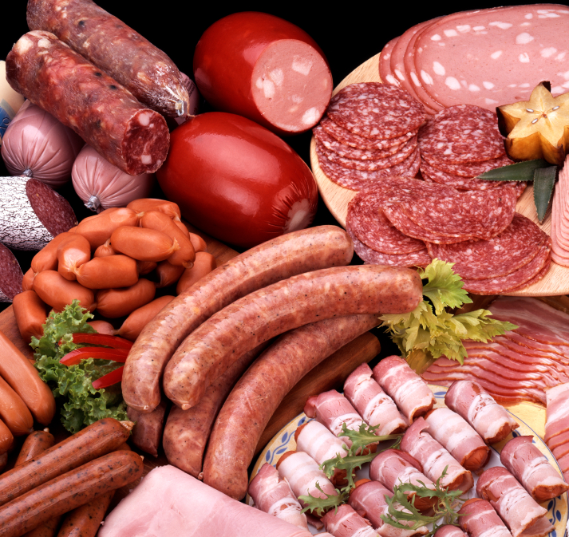

What are the main sources of salt in our diet?
75% of the salt we eat is hidden in the food we buy, particularly processed foods.
These include:
Processed meats e.g. bacon, ham and sausages
Pizza
Ready meals
Jars of cook in sauces
Shop-bought soups
Potato chips,crisps and other savoury snacks

Slide 7
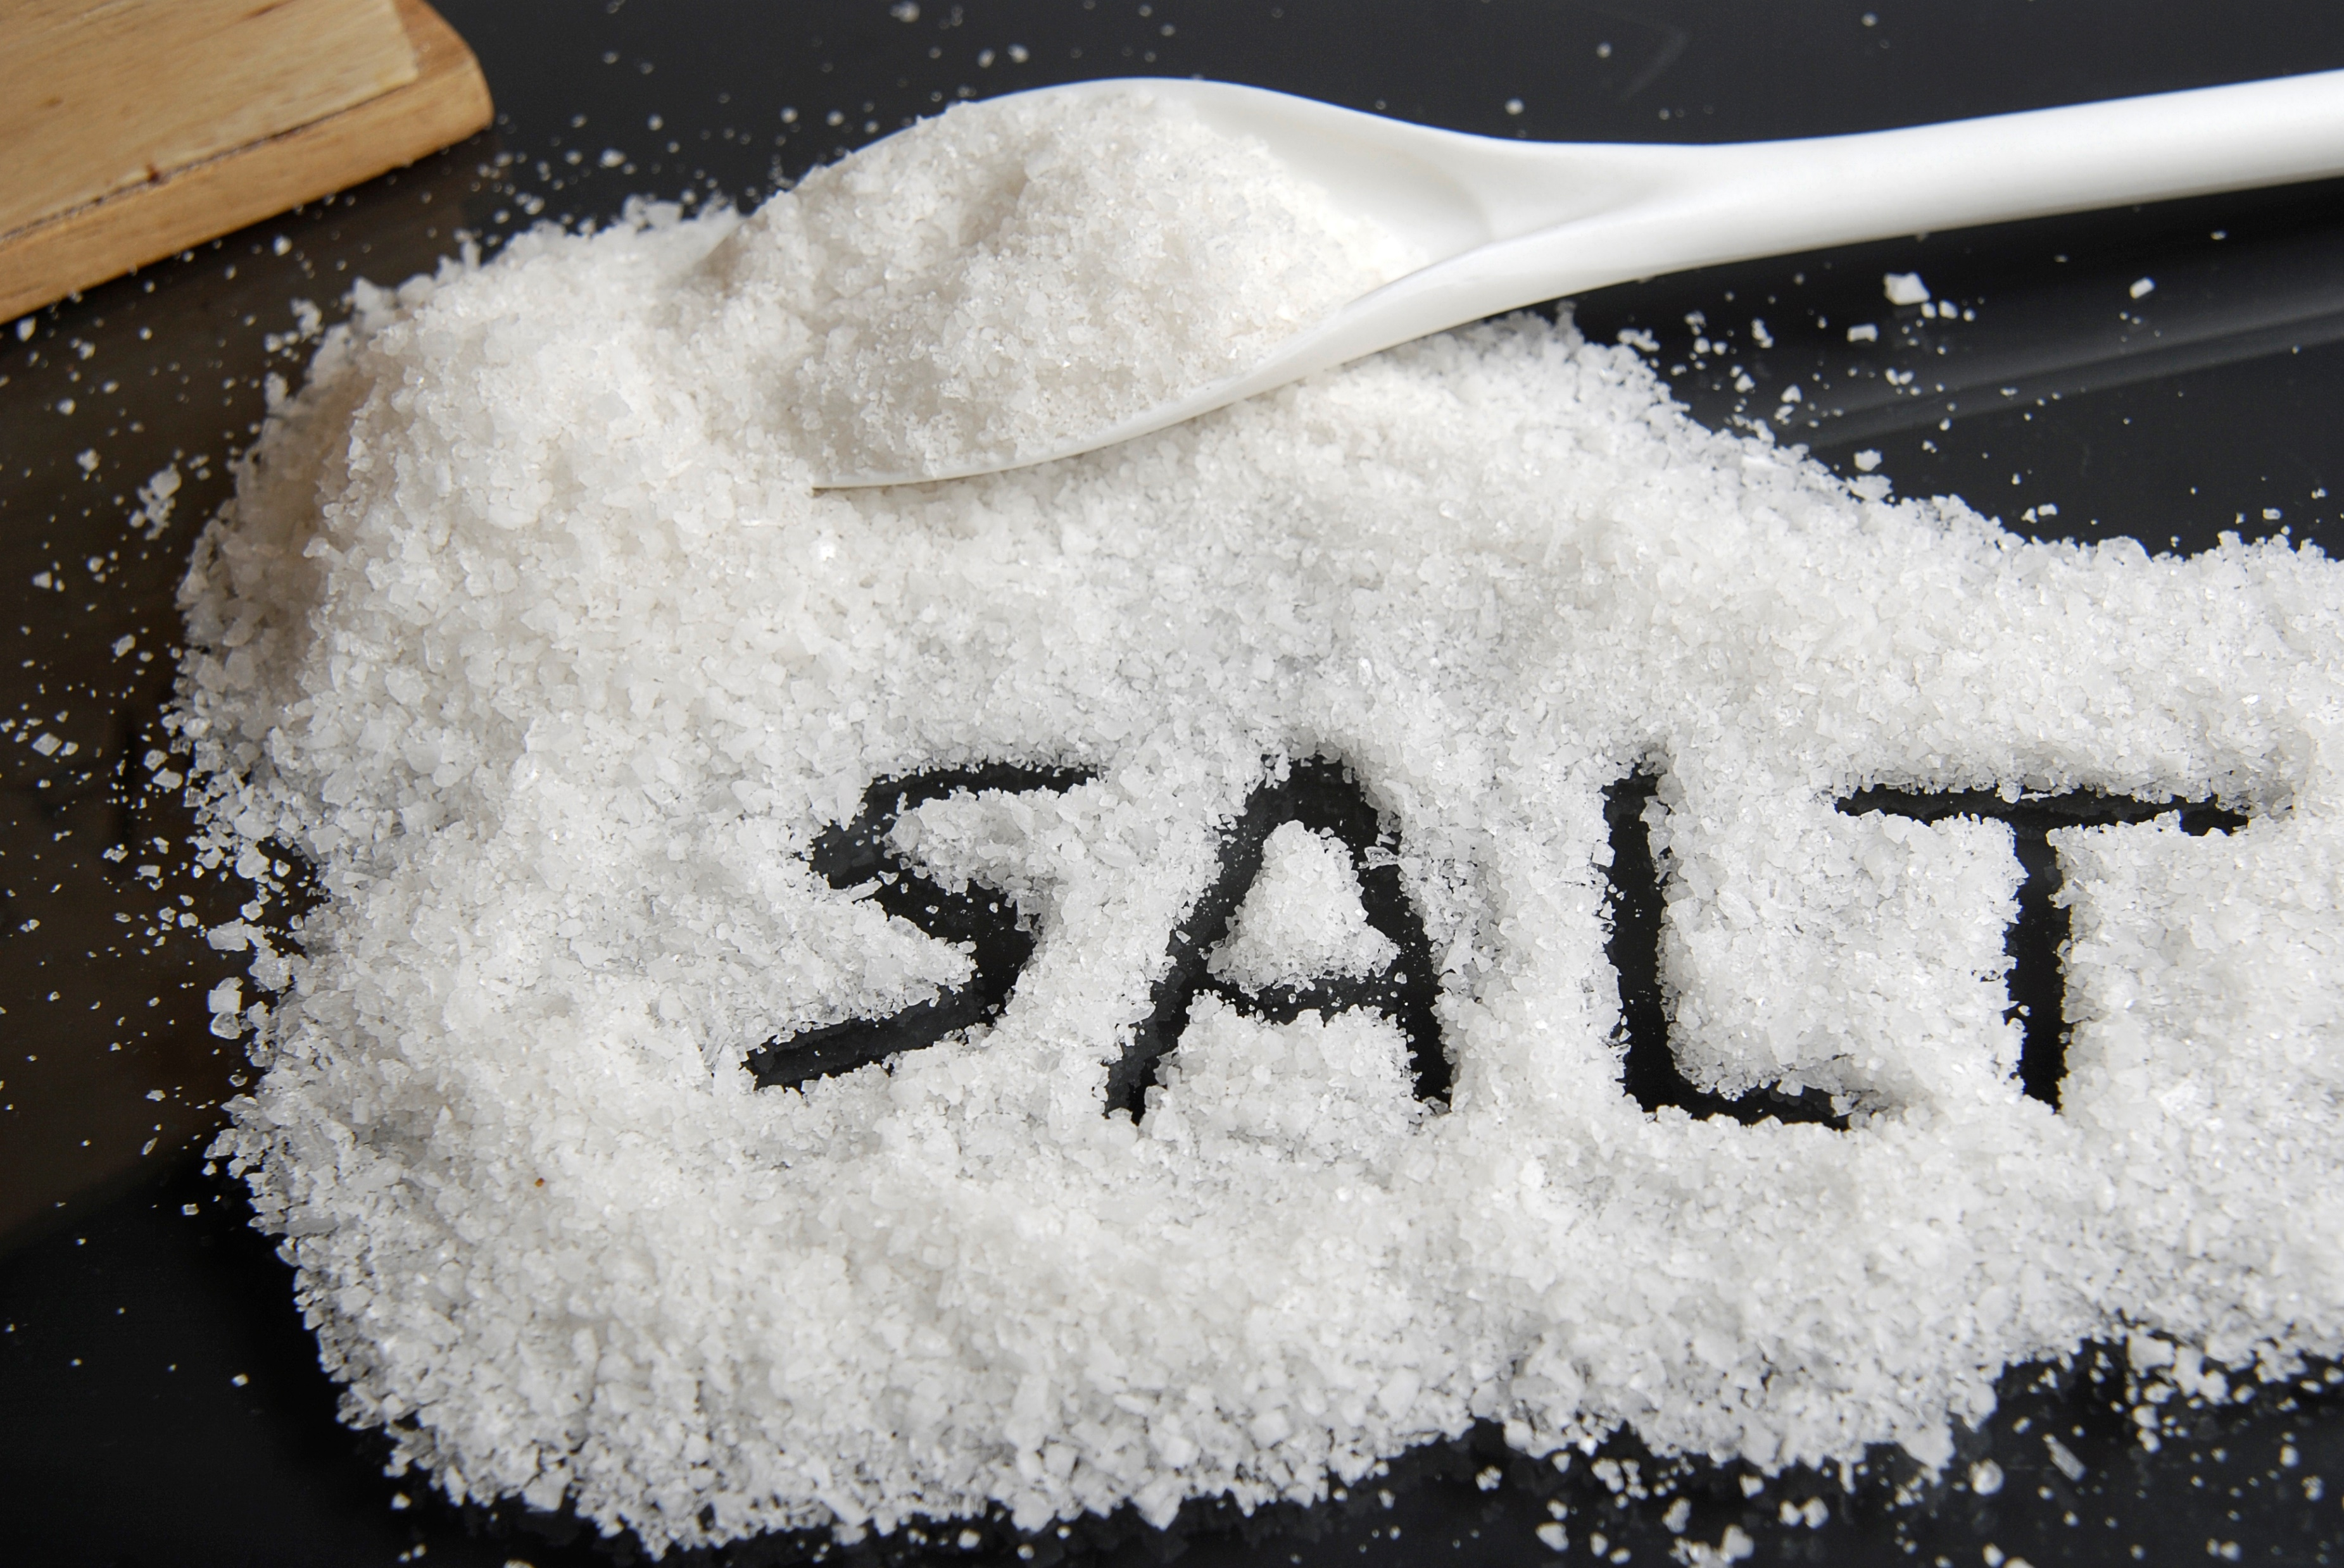
How much salt is recommended then?
In the UK, NICE recommend that we take in LESS than 6 grams (g) of salt per day. This is the recommended guideline daily amount (GDA) .
6 grams is just 1 teaspoon of salt.
Understanding food labelling will give you an idea of how much salt you are eating in your diet.

Slide 8
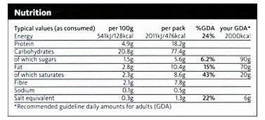
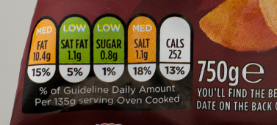
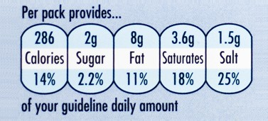
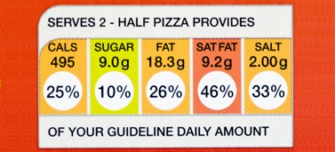
Food Labels

Slide 9
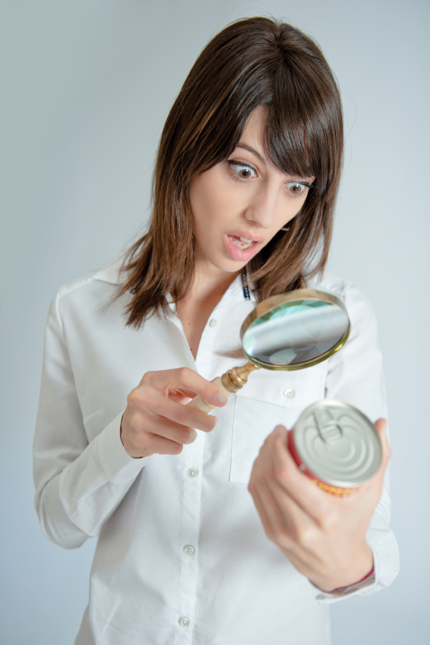
How do I understand food labels?
Compare food labels for salt content.
Look for the guideline daily amount on the food label ( %GDA).
The traffic light system uses red for high, amber for medium or green for low in a particular nutrient.
Choosing foods with more green and amber nutrients than red is a good way to make healthier choices.

Slide 10
Portion size
Remember the suggested portion size on the food label might not be the portion size you put on your plate.
Remember to adjust the amount of salt on the food label to match your portion size.
For example if the portion size on the jar is a ¼ and you are going to eat ½ jar you would need to double the salt content on the food label as this would be your actual salt intake.
Remember your portion size, to be label wise!

Slide 11
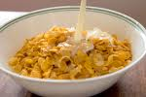
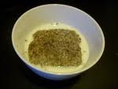
Breakfast ‘Swaps’
Swap this…
For this…
30 g bran flakes with milk
0.6 g salt = 10% of your GDA
2 weetabix with milk
0.27 g salt = 5% of your GDA

Slide 12
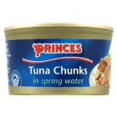

Light Meal ‘Swaps’
Swap this…
For this…
Tuna sandwich made with tuna
in spring water & salt ‘n’ shake crisps
1.24 g salt = 20% of your GDA
Cheddar cheese sandwich & ready salted crisps
2.54 g salt = 42% of your GDA

Slide 13
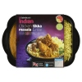
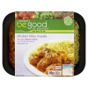
Main Meal ‘Swaps’
Swap this…
For this…
Chicken
Tikka With Rice 500g
2.77 g salt = 46% of your
GDA
Chicken Tikka Masala With Pilau Rice, Be Good To Yourself 380g
0.84 g salt = 14% of your GDA

Slide 14

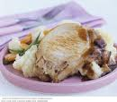
Evening Meal ‘Swaps’
For this…
Swap this…
2 Sausages and mashed potato with gravy
2.4 g salt = 40% of your GDA
Pork chop and mashed potato with gravy
0.68 g salt = 11% of your GDA

Slide 15
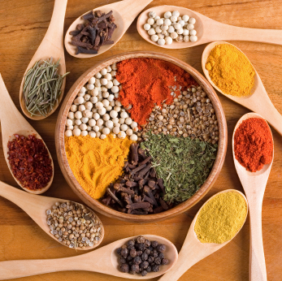
Does less salt mean less taste?
Your taste buds will adapt to less salty foods and this will allow the natural flavours of the foods to come through.
Adding flavourings such as herbs, spices, lemon garlic, chilli, ginger or curry powders instead of salt.
We don’t recommend artificial salt substitutes as they can be harmful for people with kidney disease.

Slide 16
Decision making flow chart to reduce the amount of salt in our diet
Are you cooking from fresh?
YES
Try not to add salt and use an alternative flavouring instead.
Cook extra portions for the freezer and or for lunch the next day.
NO
Are you using processed food?
Compare food labels and brands.
Choose lower salt options (Green or Amber)
Consider cooking from fresh, using alternative flavourings such as herbs and spices.

Slide 17
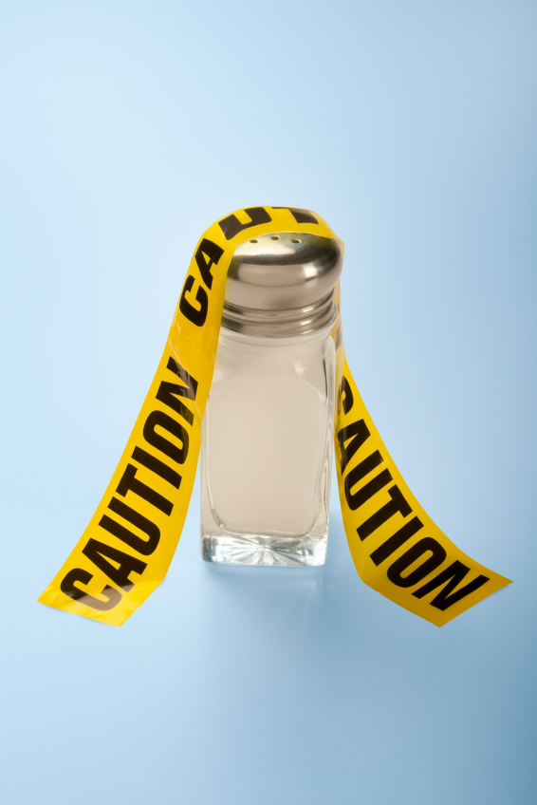
Tips on how to reduce your salt intake
Try not putting salt on the table and not adding salt during cooking.
Cook foods from fresh so you know what is in them.
Instead of salt, use black pepper, herbs and spices to flavour food.
Cut down on processed foods such as bacon, sausages, cheese and canned food containing salt.
Plan meals so you can cook extra to take for lunch the next day – this will save money too.

Slide 18
Comparing different food types & brands
Next time you are in a shop, try to pick out three items that you think are high in salt and three items that you think are low in salt.
Check their food labels to see if you are right!
Think whether these items surprised you by their salt content?

Slide 19
Additional information
Other sources of information that you may find useful are:
WASH, World action on Salt www.worldactiononsalt.com
UK NICE National Institute of Clinical Excellence www.nice.org.uk
US CDC www.cdc.gov/salt/

